Slide 1
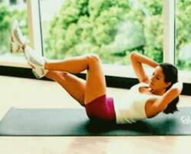
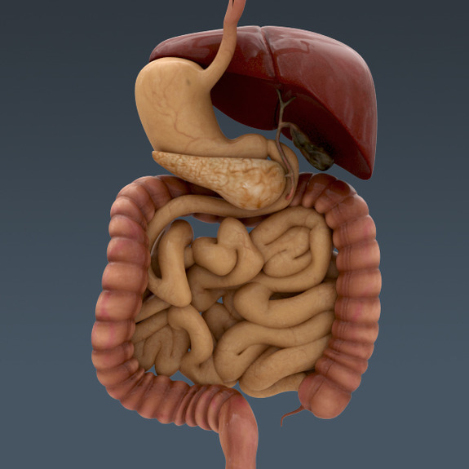
Рhysical rehabilitation in gastro-enterology

Slide 2
Мuscular work
affects the various functions of the digestive system by the principle of motor-visceral reflexes.
Changes occurring as a result of physical activity are different.
Effect of exercise is determined by the intensity and time of application:
small and moderate muscle tension stimulate the basic functions of the gastrointestinal tract,
intense muscle tensions are oppressing.

Slide 3
Аims of physical therapy in rehabilitation of gastroenterological patients:
contribute to the strengthening, improvement of the body;
an impact on the neuro-humoral regulation of digestion;
stimulation of blood circulation in the abdomen and pelvis;
strengthening the abdominal muscles;
help to normalize the secretory, motor and absorptive function;
prevent stagnation in the abdominal cavity, contribute to full function of breathing, and the ability to take advantage of diaphragmatic breathing in case of this pathology;
have a positive impact on the psycho-emotional sphere.

Slide 4
Therapeutic effect of exercise therapy is caused by
strengthening and normalizing effect on the nervous system: a balance of excitation and inhibition processes in the cortex of the brain and improvement of the performance of vegetative sections of - motor-visceral reflexes; activation of tissue metabolism: improving the nutrition of tissues and organs, increase overall body tone and performance; improving blood circulation in the abdominal organs and decreases the amount of deposited blood - there is remission of inflammatory processes in the organs of the gastrointestinal tract and accelerate the regeneration processes in them; circulation improves in the pelvic organs and prevents stagnation of blood in the rectal veins and hemorrhoids.
Physical therapy strengthens abdominal muscles enhances intestinal motility and flow of bile from the gallbladder . Abdominal muscles play a significant role in the fixation of the abdominal cavity, and in case of their weakening the internal organs are shifted downward (called visceroptosis).

Slide 5
Contraindications to physical therapy:
period of acute illness,
severe pain,
expressed dyspepsia;
general contraindications
exercises for abdominal muscles in the
subacute stage of the disease are excluded.

Slide 6
Therapeutic effect of exercise therapy significantly improved if:
special physical exercises are performed by muscle groups which receive innervations from the same spinal segments as the diseased organ:
stomach - C3-C4,
liver, gallbladder - C3-C4, Th6-Th10,
Pancreas - C3-C4, Th6-Th10.
This exercise involves the following muscles:
neck,
trapezoidal,
muscles, raising the blade,
rhomboid major and minor muscles,
aperture,
intercostal muscles,
anterior abdominal wall,
iliopsoas, obturator,
muscles of the foot and lower leg.

Slide 7
In case of diseases of the digestive organs the efficiency of physical therapy depends on the choice of starting positions, allowing differentially regulate intra-abdominal pressure.
The most commonly used positions:
lying down with legs bent (on the left or right side, on the back);
kneeling,
on all fours,
standing and sitting.

Slide 8
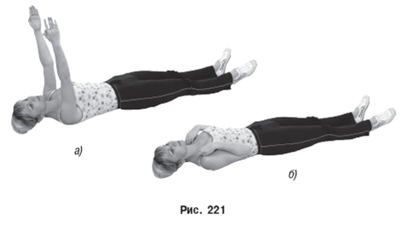
Lying positions
recommended during and immediately after acute exacerbation of the disease as the most sparing ones, contributing to the smallest functional shifts to ensure the best conditions for performing breathing exercises (lying on your back with legs bent), any relaxation of the muscles.
These positions are also useful when performing exercises for the abdominal muscles and pelvic floor.

Slide 9
Positions lying on left side, standing on all fours
As a consequence of the anatomical and topographical relationship of the gallbladder, common bile duct and duodenum, and in these positions bile flow towards the neck of the bladder and the ampoule is influenced by hydrostatic pressure.
Also increased intra-abdominal pressure accelerates the flow of bile during full breathing with an emphasis on the participation of the diaphragm and abdominal muscles.

Slide 10
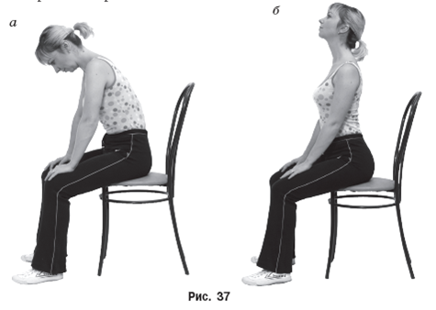
Original position on one’s knees (on all fours)
used when it is necessary to limit the impact on the abdominal muscles, to cause mechanical movement of the stomach and bowel loops.
Standing or sitting positions
are used for the greatest impact on the digestive organs.

Slide 11
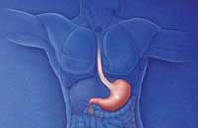
Physical therapy in case of gastritis
In case of acute gastritis PT is prescribed after subsiding of pain, nausea, vomiting .
Exclude exercises for abdominals.
Use restorative exercises for the arms, legs in combination with breathing are applied.
In chronic case without exacerbating, physical therapy features depend on the nature of the secretion.
When secretion is reduced the load should be moderate.
Use restorative and special exercises for the abdominal muscles and abdominal breathing in standing, sitting, lying down positions are applied, walking for 20-30 min.
Procedure is carried out before receiving mineral water.
At normal and elevated secretion total physical activity should be larger and even submaximal.
Limit and reduce exercises for abdominals.
PT is performed after receiving the mineral water before ingestion.
Walking, swimming, rowing, skating, skiing, outdoor
and sports games are recommended.

Slide 12
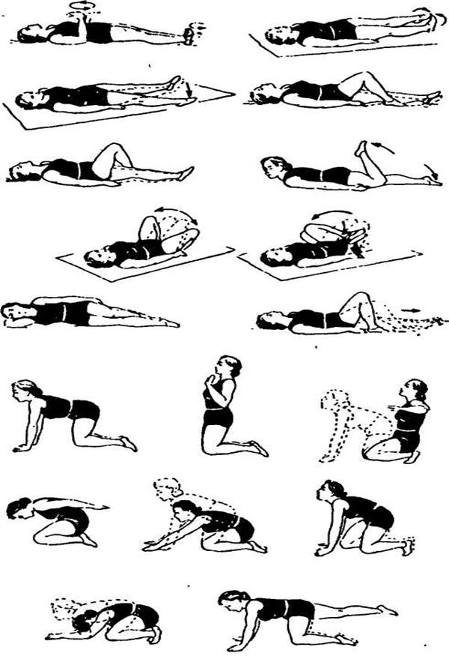
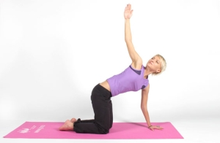
A set of exercises for gastritis

Slide 13
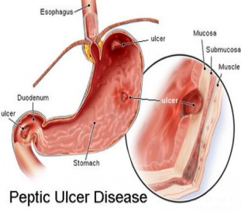
Exercise therapy in gastric ulcer and 12 duodenal ulcer
PT is prescribed only in subacute and chronic stages, when there is no severe pain, persistent nausea, vomiting, bleeding.
Assign after 2-5 days after their discontinuation.
During this period in the supine position simple exercises for arms and legs in alternation with respiratory static and dynamic exercises are performed. In the presence of niches and blood in the stool gymnastics can be assigned, but there must not be used exercises for the abdominals and those which increase intra-abdominal pressure.
As the complete disappearance of pain the load gradually and carefully increases. IP-lying, sitting and then standing, duration of treatment - 15-20 min. During the chronic use exercises with larger load special for abdominals. also volleyball, rowing, skiing, swimming are recom-
mended.

Slide 14
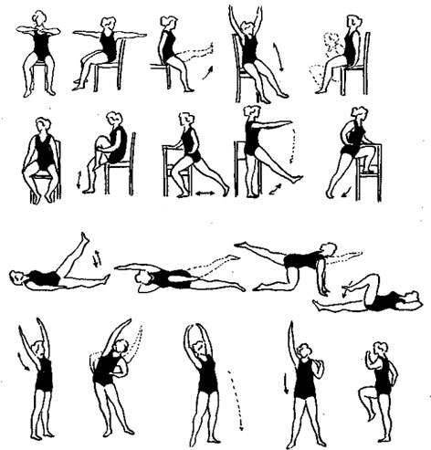
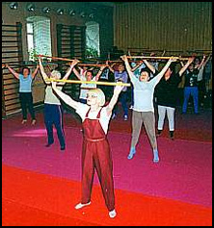
A set of exercises for peptic ulcer

Slide 15
PT with biliary dyskinesia
Depending on the functional impairment of contractility of the gallbladder dyskinesia is divided into hyperkinetic (hypertension, spastic) and hypokinetic
(hypotonic, atonic form).
According to the clinical forms,
the physiotherapy technique differentiates.
In case of hypokinetic form the conditions to facilitate the outflow of bile from the gallbladder should be created.

Slide 16
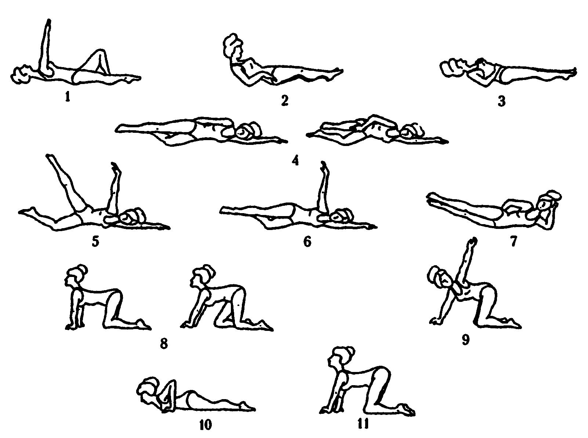
A set of exercises with gallbladder dyskinesia

Slide 17
PT in hypokinetic form
General exercise load is medium.
IP is different: lying on the back, on the side, standing, sitting, on all fours, on the knees and others, in remission stage, sitting or standing positions prevail .
IP - lying on the left side to improve the outflow of bile .
For better emptying of the gall bladder and bowel function activation, a variety of exercises are done with gradually increasing load for the abdominal muscles ( including IP - lying on his stomach ) and breathing exercises .
Breathing exercises are carefully coupled with a slowdown of respiratory movements on inspiration and expiration, and even help to reduce pain and dyspeptic symptoms.
Exercises performed with full amplitude.
various types of walking are included.
It is necessary to teach the patient to receive muscle relaxation. Only the right combination of elements of effort and relaxation will ensure success of the procedure.
The tempo is average.
Sedentary games can be used with the first procedures , moving - in remission. The duration of 20-30 minutes .
Before classes passive recreation needs a few minutes. First 8-10 physiotherapy procedures are performed every other day, then every day (2 times a day is possible) .

Slide 18
PT with hyperkinetic form
At first sessions small physical activity is given, followed by an increase to its average.
Various IP is possible, supine position predominates - it is most effective for muscle relaxation.
Avoid expressed static stress , especially for the abdominal muscles.
Exercises for the abdominal muscles should be alternated with their relaxation.
Showing the static and dynamic breathing exercises, breathing exercises on the right side to improve the circulation of the liver, flight movements at first limited and then full amplitude, exercise with simulators and wall bars.
Exercises, normalizing bowel function are necessary. Variety of restorative exercise improve the heart muscle and blood flow from the liver.
Tempo is slow, transition to middle.
You can include elements of sedentary games.
During the group classes competitive moments in games are not recommended.
Length - 20-30 min.
Before assuming passive recreation needs for 3-7 minutes in the supine position. While relaxing the patient can produce self-massage of the abdomen, not capturing the area of the liver in the presence of even slight pain in the right upper quadrant.
First 10-12 procedures performed in a day in the future - every day.
After patient education, an instructor can recommend them individual classes at home.

Slide 19
Visceroptosis
Visceroptosis (prolapse of internal organs) is associated with weakness of muscles and ligaments that hold the internal organs in the normal position.
Can be congenital or caused by constitutional asthenia.
Acquired failure occurs due to the weakening and distension of the ligamentous apparatus and abdominals.
With significant weight loss, multiple births in women, the constant physical stress
(hard physical labor, power sports, etc.). As a result, the stomach, the intestines and the pelvic organs shift downward, and ligaments that hold them are overstretching.

Slide 20
Visceroptosis
PT aim: general strengthening of the body, increase of mental tone, improve the function of the stomach and intestines, creating a muscular corset (due to the abdominal muscles and muscles of the perineum).
PT is carried out in a hospital in compliance with the driving mode and a balanced diet, wearing special bandage and massage.
Important conscious attitude of the patient to treatment - physical therapy course lasts 2-2.5 months. And daily PT activities take from 2.5 to 4 hours
Basic methods of PT - exercise (mainly for abdominal muscles and the perineum , breathing exercises ) and autogenous training.

Slide 21
Visceroptosis
Among all the diseases of the gastrointestinal tract, only in case of visceroptosis such strict adherence of starting position is needed - lying on the back on the couch with a raised leg end, on all fours.
In these initial positions stomach and transverse colon become at normal anatomic relationships, and blood circulation improvement contributes to the normalization of trophic processes in the ligament- muscular apparatus.

Slide 22
Visceroptosis
Original standing position is recommended to include the classes only after strengthening the abdominal muscles and pelvic floor.
Used special exercises: body rotations, abduction - adduction and rotation of the lower limbs, retraction of the anus, isometric contraction of the glutei muscles and muscles of the perineum (the exposure to 5-7), walking with “crossing” step, etc.
Special exercises are held on the background of respiratory and common exercises; exercises to foster a correct posture are recommended, improvement of coordination.

Slide 23
Visceroptosis
Do not apply too diverse and complex to change them often, since learning the exercises right away a considerable amount of time ( sometimes up to one week).
Therapeutic effect begins to emerge only after the patient has mastered the exercises.
PT complex should not be changed earlier than one month.
To increase the amount of physical activity, the number of repetitions and duration of exercise classes should be increased.
Upon reaching the clinical effect, the patient should continue to engage in lifelong recreational gymnastics (20-30 minutes daily).
Exercises which may cause displacement of the abdominal organs down
are prohibited: strength training, sharp torso bends, jumps , lift loads weighing more than 5 kg, exercises that improve the intra-abdominal pressure .
Massage. Region of the abdomen is massaged and stroking frolement (clockwise). After that you should move on to the back massage (rubbing, kneading and stroking).
Self-massage is also applied.

Slide 24
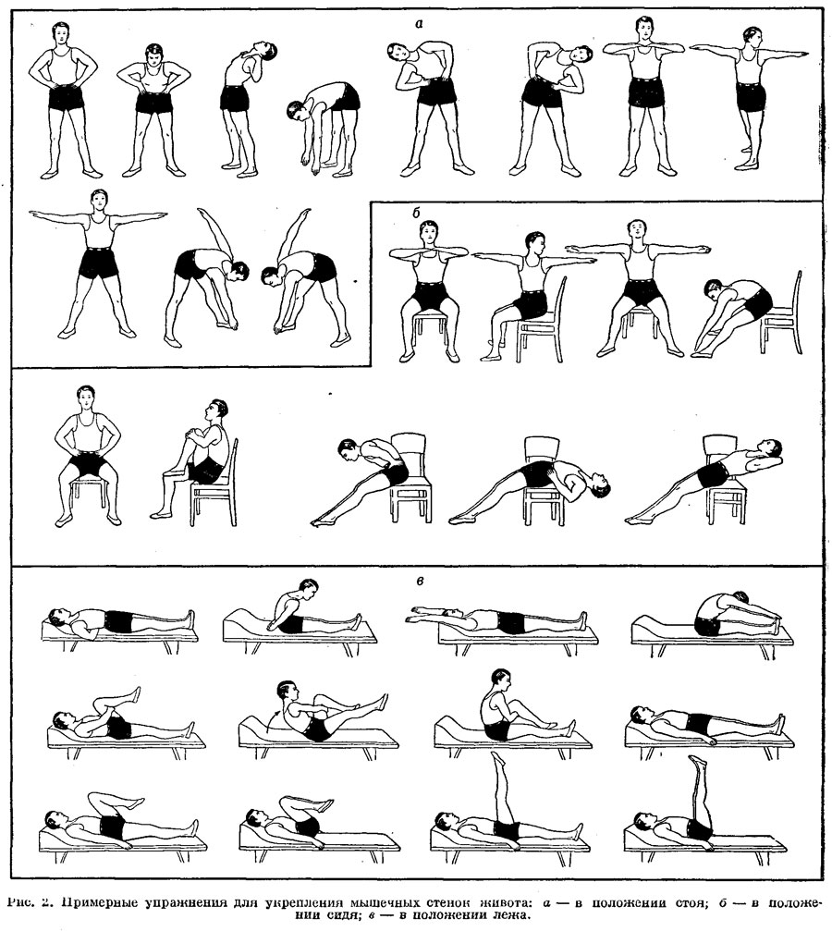
a
Sample exercises to strengthen the muscle wall of the abdomen:
standing;
in a sitting position;
in the supine position.
b
c

Slide 25
Exercise therapy in chronic pancreatitis is aimed at
strengthening the nervous system through a tonic effect on the neuro-psychological condition of the patient;
normalization, and then increasing metabolism and improve the functional state of the organism;
to improve blood circulation in the abdominal cavit;
training, diaphragmatic breathing (diaphragm like “massaging” the pancreas that improves its function).
The tempo is slow and average, the duration is 15-20 minutes. The complex physical therapy, except for special exercises, walking outdoors at a distance of 1-2 km at a pace familiar to the patient is included.

Slide 26
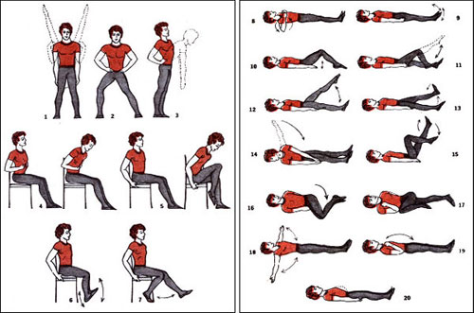
A set of exercises for physical therapy in patients with chronic pancreatitis (by A.M. Kapitonenko, 1986)

Slide 27
Therapeutic exercise for constipation
The purpose is to strengthen the general condition of the patient, regulate the function of the autonomic nervous system and improve the condition of the abdominal muscles.
When primary atonic constipation apply active and deep self-massage on the abdomen background bracing exercises and alternating with respiratory movements and distracting special exercises for the abdominals.
Duration of physiotherapy 15-35 minutes.

Slide 28
Therapeutic exercise for constipation
Also important are exercises to develop the abdominal muscles, including the pelvic floor muscles and the diaphragm, with the gradual complication of exercises
in different starting positions: lying on your back, side, and knees, kneeling, sitting, and also in the transition from one position to another. Paced movements calm and moderate. Exercises are performed rhythmically, with a gradual increase in the amplitude of movement. Each exercise is repeated 10-15 times.

Slide 29
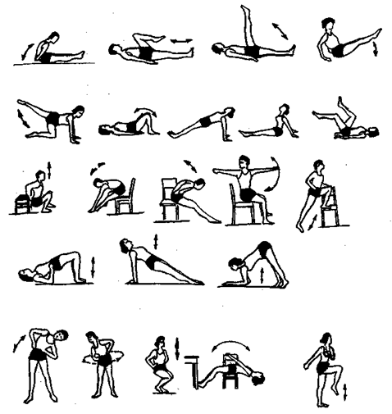
Approximate complex of PT for colitis

